Slide 1

Why optimization matters
SMALLER IMAGES MEANS:
FASTER DEPLOYMENTs
Lower storage costs
Quicker builds
Less vulnerabilities

Slide 2
Common Problems with Docker Images
Huge Image Sizes (due to unnecessary layers or dependencies)
Slow Builds & Caching Issues (improper layering)
Security Vulnerabilities (outdated base images, unnecessary packages)

Slide 3
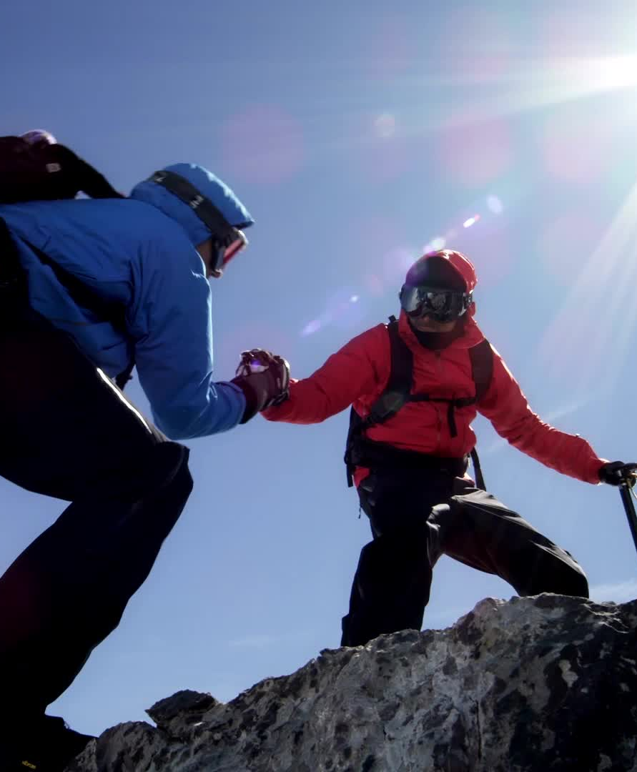
Best Practices to Optimize Docker Images
1. Use a Lightweight Base Image
Instead of ubuntu, use alpine
Example:
dockerfile
FROM alpine
Why? Alpine is 10x smaller than Ubuntu.

Slide 4
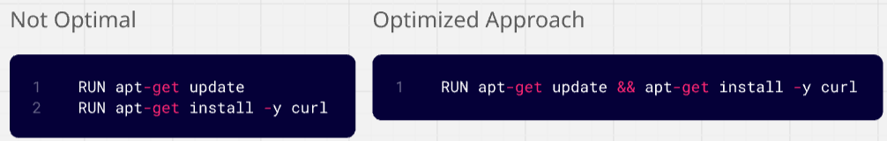
Best Practices to Optimize Docker Images
2. Reduce the Number of Layers
Combine commands using && to keep it clean

Slide 5
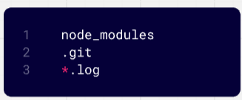
Best Practices to Optimize Docker Images
3. Use .dockerignore to Exclude Unnecessary Files
Example .dockerignore:
Why? Prevents bloated images with unnecessary files.

Slide 6
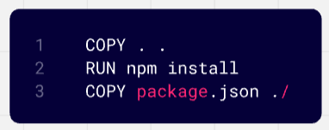
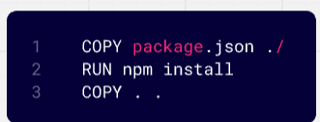
Best Practices to Optimize Docker Images
4. Optimize Layers & Caching
Place COPY and RUN commands in the right order to leverage caching.
Why? Changes in the source code won’t force unnecessary dependency reinstalls.

Slide 7
Best Practices to Optimize Docker Images
5. Use Multi-Stage Builds
Why? With multi-stage builds, Docker allows you to:
Use a separate stage to build the application.
Copy only the necessary files into a clean, final image.
Keep the final image small and efficient.

Slide 8
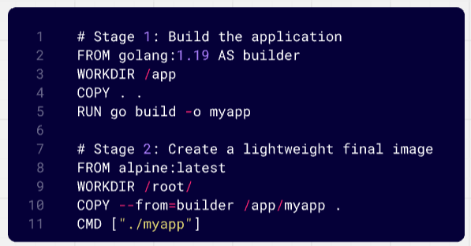
Docker Multi-Stage Build

Slide 9
Docker Multi Stage Demo (Without Stages)
mkdir go
cd go
vim main.go
package main
import "fmt"
func main() {
fmt.Println("hello, world")
}
vim dockerfile
FROM golang:1.23
WORKDIR /src
COPY main.go .
RUN go build -o /bin/hello ./main.go
CMD ["/bin/hello"]
docker build –t go:v1
docker image ls

Slide 10
Docker Multi Stage Demo (With Stages)
mkdir go
cd go
vim main.go
package main
import "fmt"
func main() {
fmt.Println("hello, world")
}
vim dockerfile
FROM golang:1.23 AS build
WORKDIR /src
COPY main.go .
RUN go build -o /bin/hello ./main.go
FROM scratch
COPY --from=build /bin/hello /bin/hello
CMD ["/bin/hello"]
docker build –t go:v2
docker image ls
docker run –d --name go-v1 go:v1
docker run -d --name go-v2 go:v2
docker logs go-v1
docker logs go-v2

Slide 11
Best Practices to Optimize Docker Images
6. Always scan images for security vulnerabilities and keep them updated. This will secure your images.
Use tools like Tattler, Tenable, Trivy etc.

